Slide 1

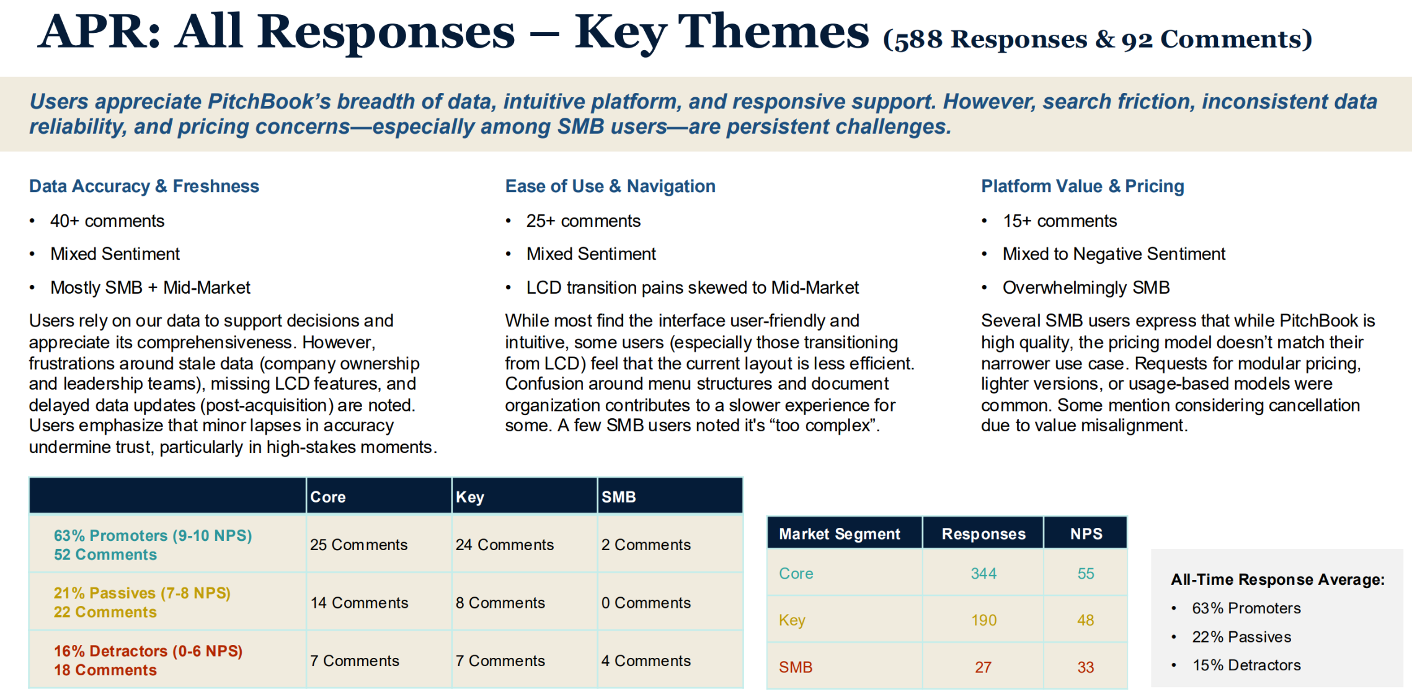
Pitchbook Data– Agentic AI Governance
Business Need
PitchBook’s marketing team was expanding its use of off-the-shelf AI tools, including ChatGPT, to support content creation, campaign planning, and analysis. As usage increased across the team, PitchBook needed a clear governance framework to ensure consistent, responsible, and compliant use of AI tools while protecting brand standards, sensitive data, and intellectual property.
What We Did
Developed an AI governance framework focused on marketing use of tools such as ChatGPT and similar AI platforms
Defined approved use cases, guardrails, and usage standards for AI-assisted marketing activities
Established guidelines for data handling, prompt usage, and protection of confidential information
Created review, approval, and documentation standards to ensure consistency and accountability
Delivered a practical governance document aligned with legal, compliance, and brand requirements
Azure AI Foundry
Results
Enabled marketing teams to confidently adopt AI tools in day-to-day workflows
Reduced risk related to data exposure, brand misuse, and inconsistent AI usage
Improved consistency and quality of AI-assisted marketing outputs
Created shared alignment across marketing, legal, and technology stakeholders
Provided a scalable foundation for future AI capabilities and tools

